Slide 1
Covid -19 Tracker
Here is where your presentation begins

Slide 2
What is COVID-19? Who is at risk?
COVID-19 is a new illness caused by a virus called coronavirus.
It can affect your lungs and airways.
It is spread through droplets from the nose and mouth- example by talking loud, singing, shouting, coughing or sneezing. Droplets containing the virus can also fall onto surfaces. If you touch that surface and then touch your eyes, nose or mouth, you could also become infected.
Coronavirus (COVID-19) can affect anybody.
For some people however, the risk is much higher.
There are 2 levels of higher risk:
high risk
very high risk

Slide 3
COVID-19 Symptoms
If you have any common symptoms of coronavirus (COVID-19), self-isolate and phone your GP straight away (or out of hours GP service- evenings/weekends) to get referred for a coronavirus test
Common symptoms of coronavirus include:
Fever (high temperature - 38 degrees Celsius or above)
Cough - any type of cough, not just dry
Shortness of breath or breathing difficulties
Loss or change to your sense of smell or taste

Slide 4
How to Prevent COVID-19
WASH
STOP
DISTANCE
Your hands well and often to avoid contamination
Shaking hands or hugging when saying hello or greeting other people
Yourself at least 2 meters(6 feet)
Away from other people

Slide 5
DO’S AND DON’T
2
4
1
3
5
SAINITIZATION
WEAR MASK
Don’t touch
Dispose
Remove
Wash Hand properly
Always wear mask in public areas
Don’t touch your face while wearing
After using dispose it
Carry a second mask , in need.

Slide 6
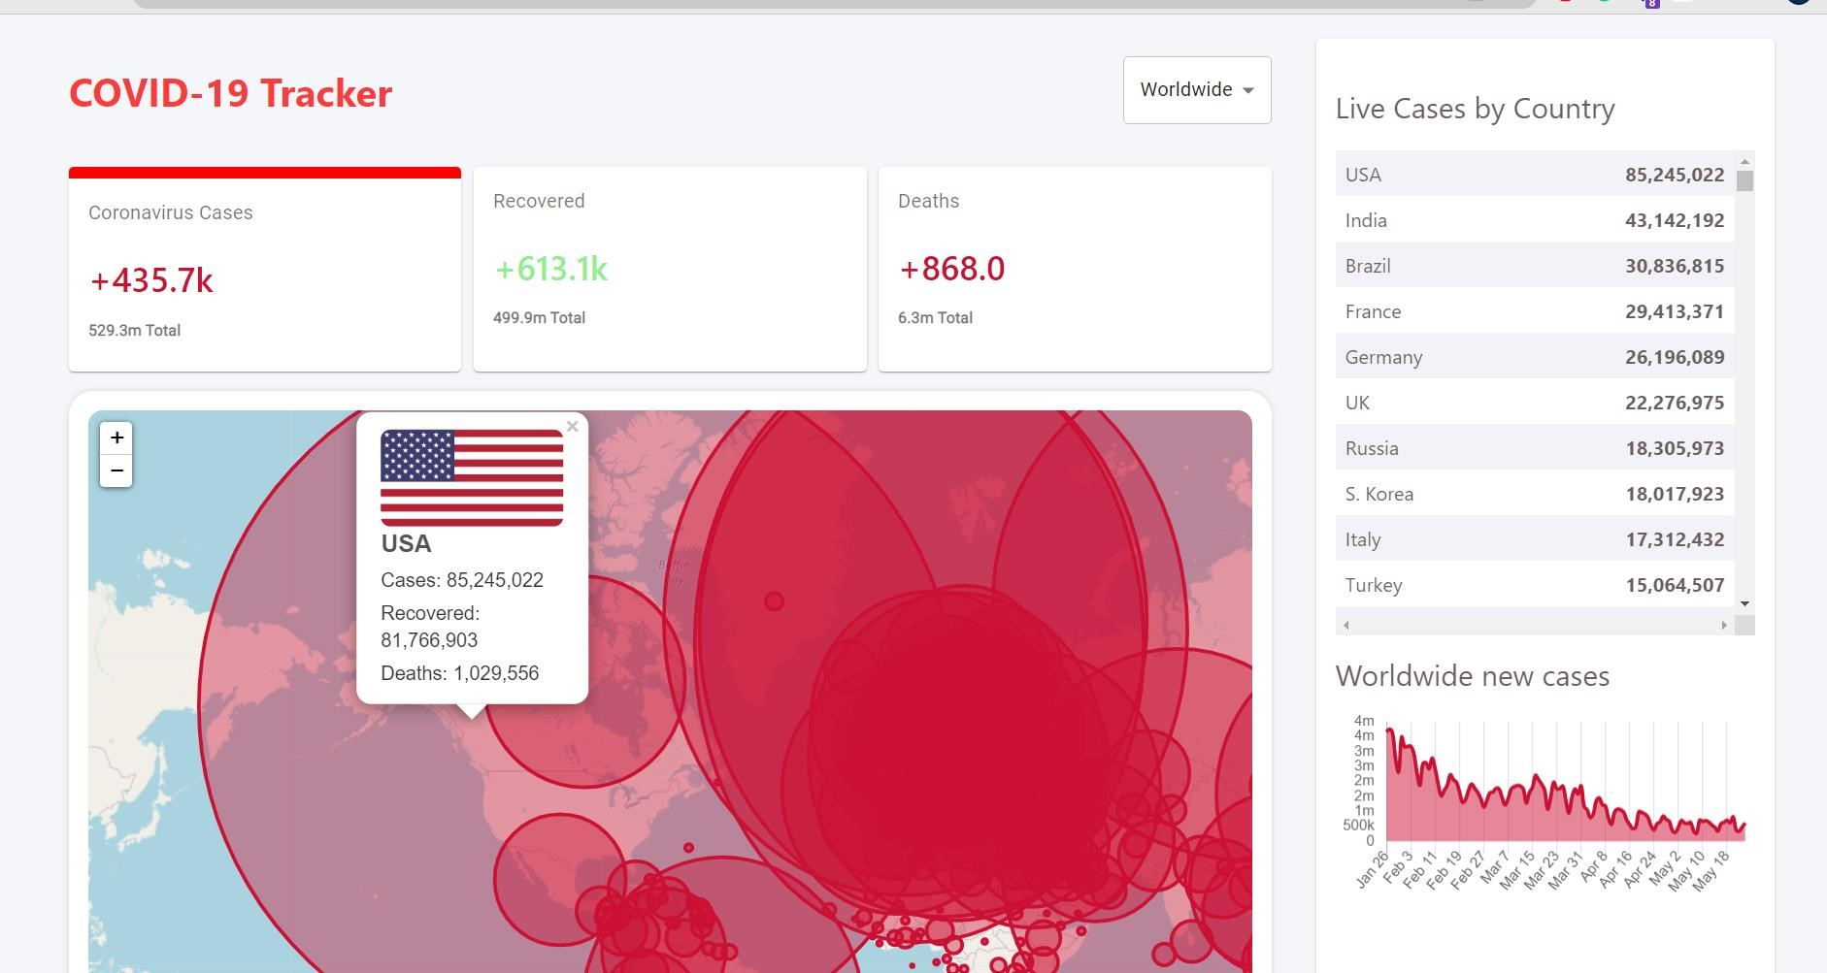
COVID-19 TRACKER APP
This is the front page of our APP, It consists of columns which shows total number of deaths cases, total live cases and the recovered cases ,Across the World.

Slide 7
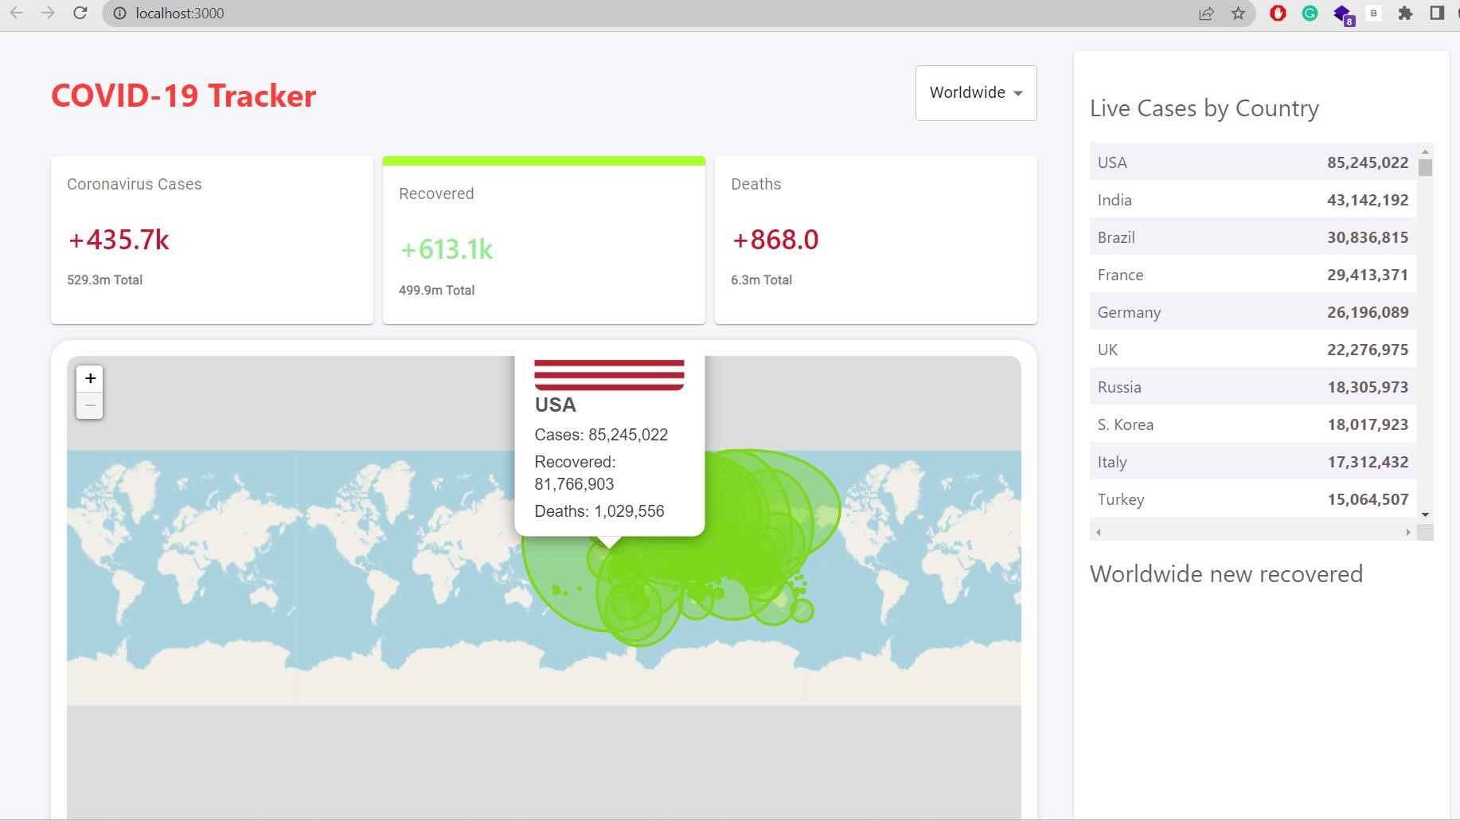
Here, the GREEN column shows the Recovered Cases.

Slide 8
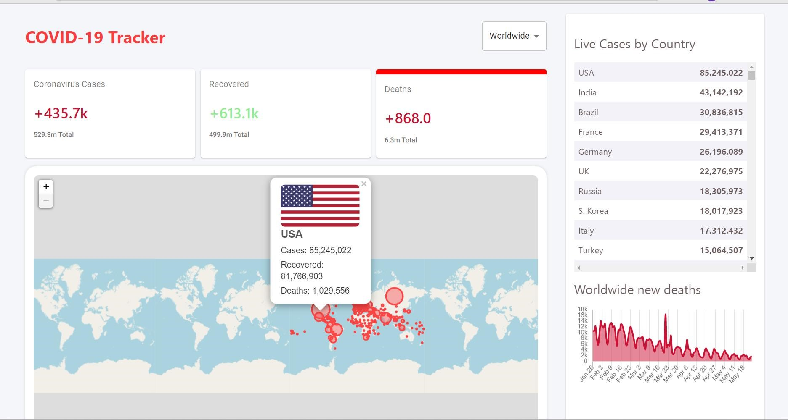
Here, is the RED column shows the Death Cases.

Slide 9
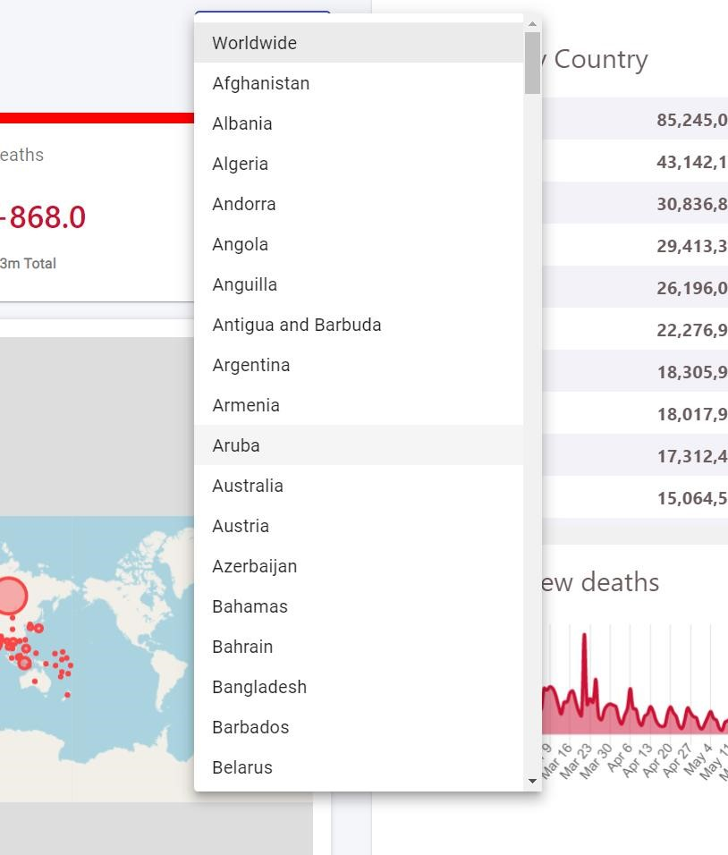
This is column where all the countries are listed and from where , After selecting the Specific Country , We can Track COVID-19 cases.

Slide 10
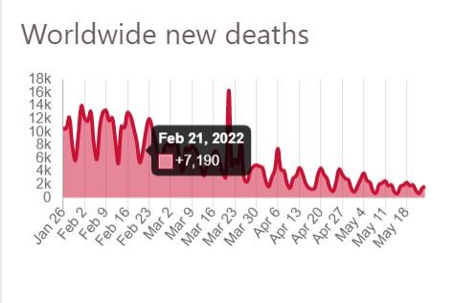
GRAPHICAL REPRESENTATION OF NEW DEATHS CASES.

Slide 11
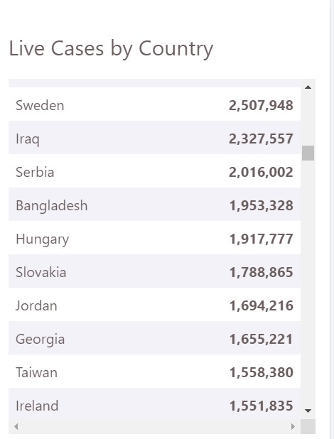
COLUMN OF LIVE CASES BY COUNTRIES ACROSS THE WORLD.

Slide 12


